Slide 1
Things to think about…
Shape of model outline
Lumping Yarragadee as one unit?
Why structural models look different?
Water balance – what’s coming in and what’s going out, and how to model that
Observation bores – how many to include for calibration, making plots

Slide 2
Otorowiri Aquitard
Explore geometrical controls on Leederville-Parmelia Aquifer
Maybe look at water balance, and climate resilience?

Slide 3
Might need a fake surface to inspire lithology to smile!
Maybe not.
Ground surface
For Loop, just use a constant z value
For flow model, use DEM
Bottom of Kp
Data collected from…. X boreholes and AEM?
In Loop, need xyz of contacts

Slide 4
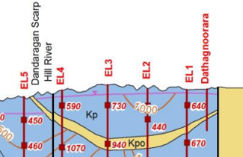
Modelling using horizontal K tensor
Modelling using K tensor that follows stratigraphy
I’m not sure using a horizontal tensor would produce a “spring” unless horizontal flow was so large and dammed at barrier, causing the overflow?
Need a mass balance in basin: Aerial recharge, Flow in by Arrow smith, flow out by arrowsmith?

Slide 5
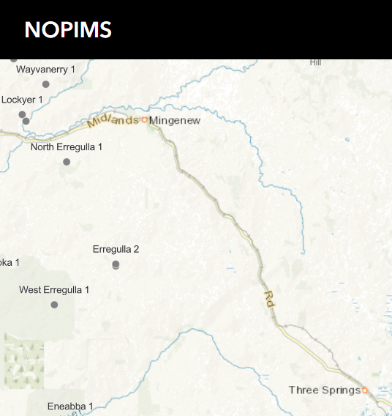
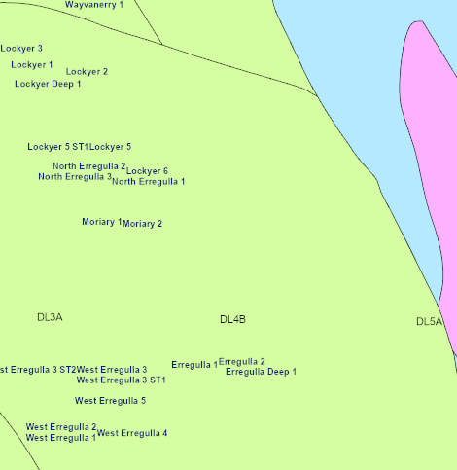

Slide 6
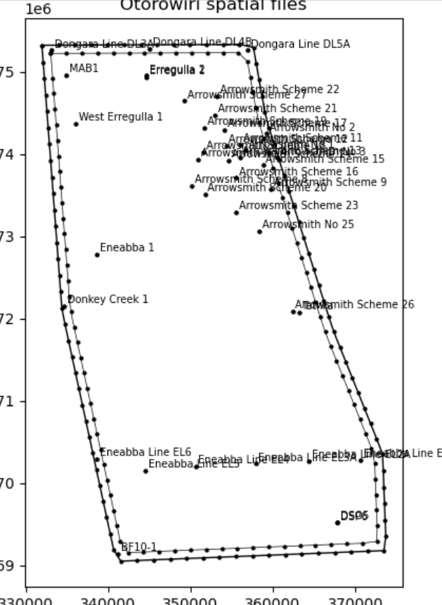

Slide 7
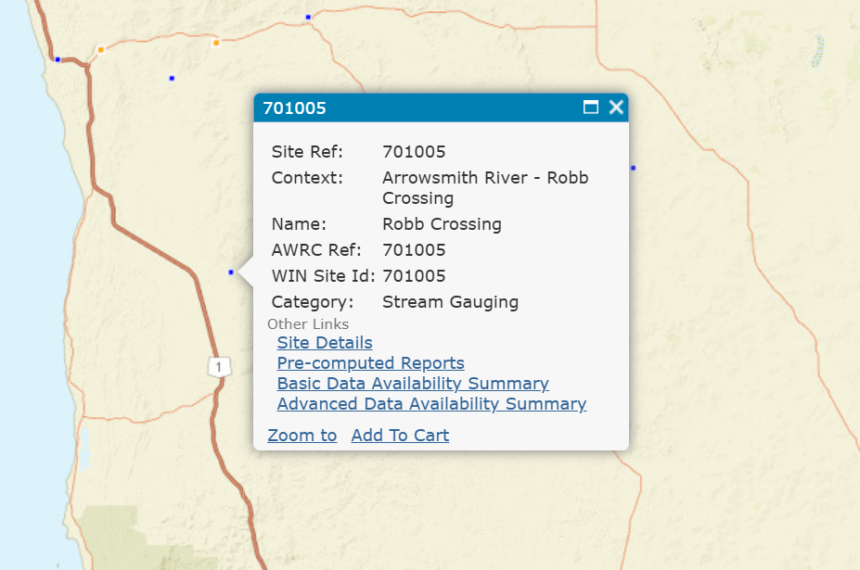
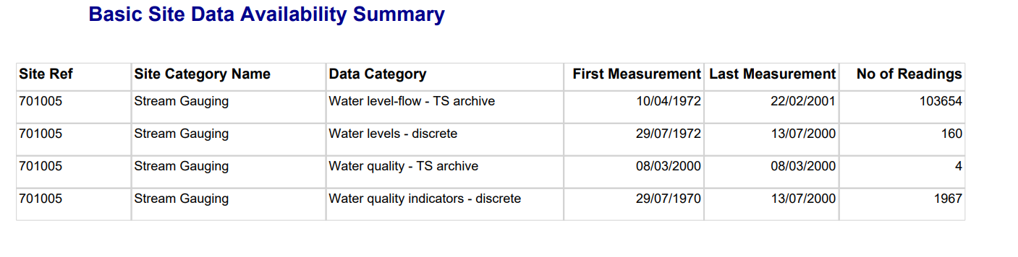

Slide 8
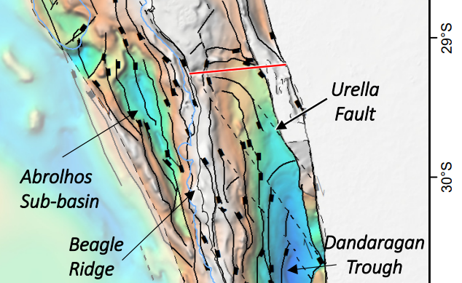
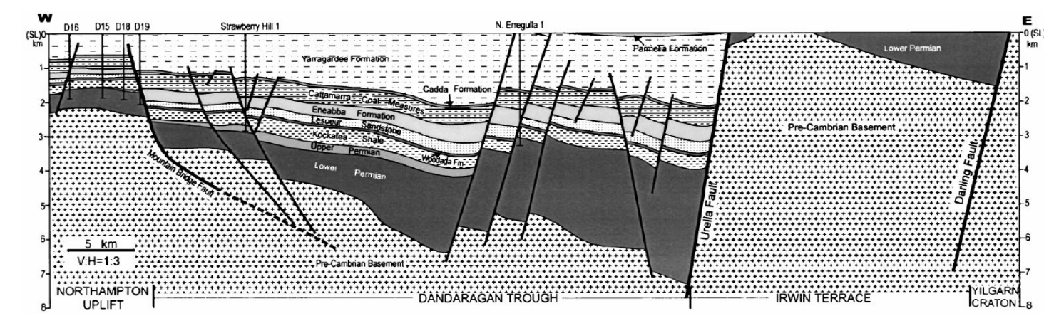
SEEBASE 2022

Slide 9
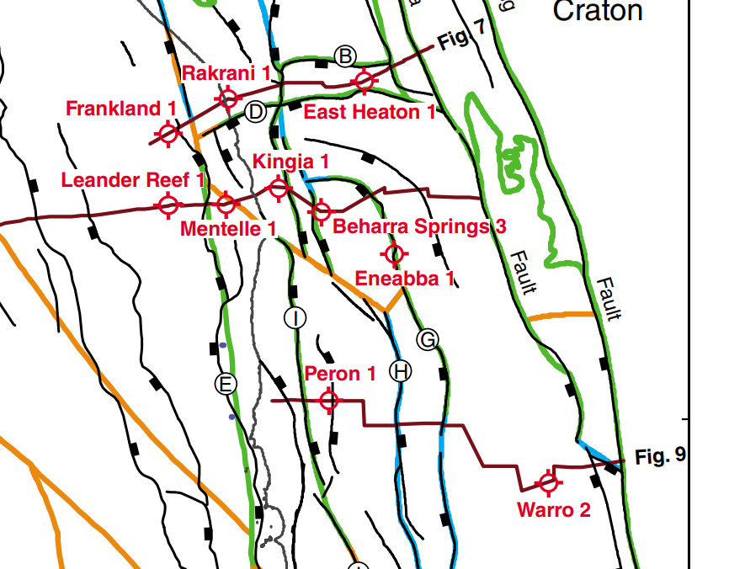
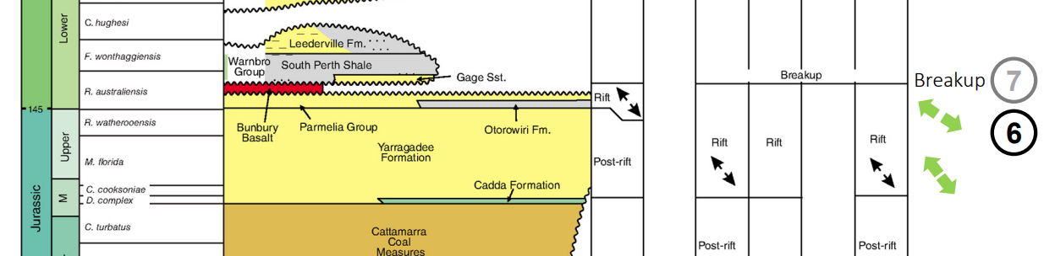
Tectonic framework, 2014, GSWA

Slide 10
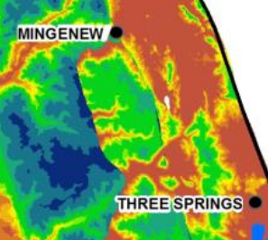
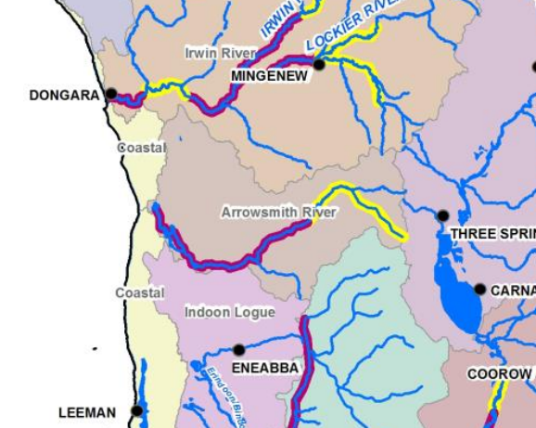
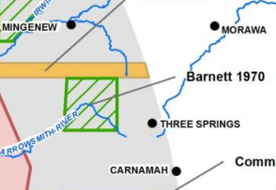
Depth to watertable

Slide 11
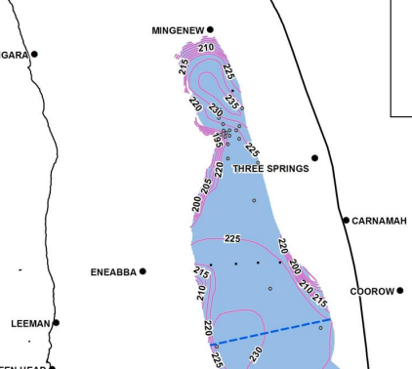
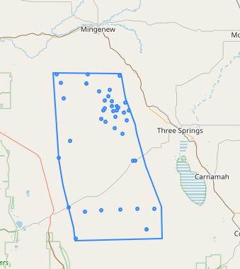
Groundwater Divide

Slide 12
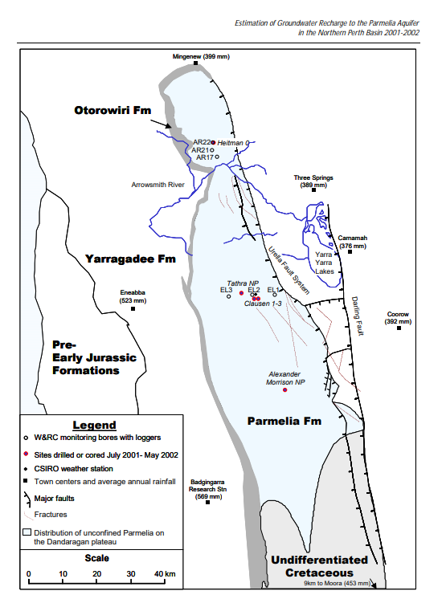
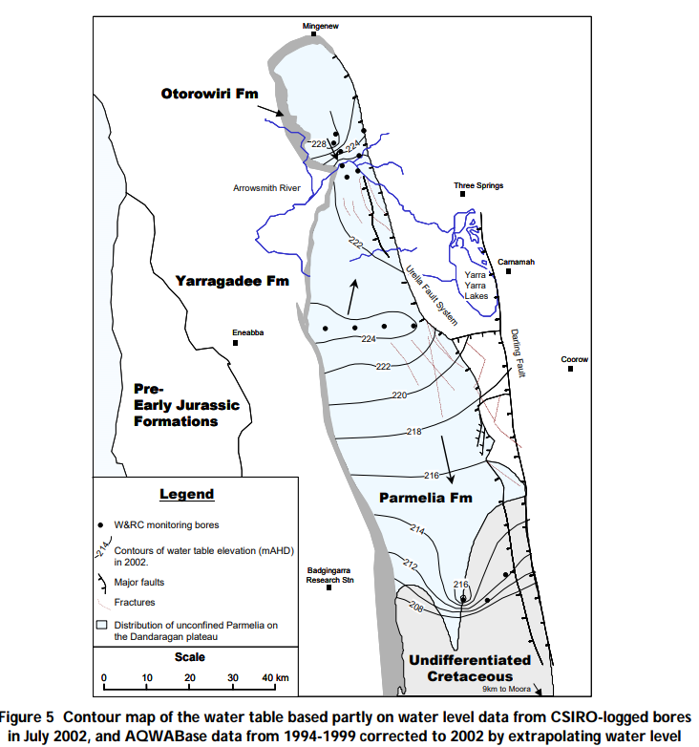

Slide 13
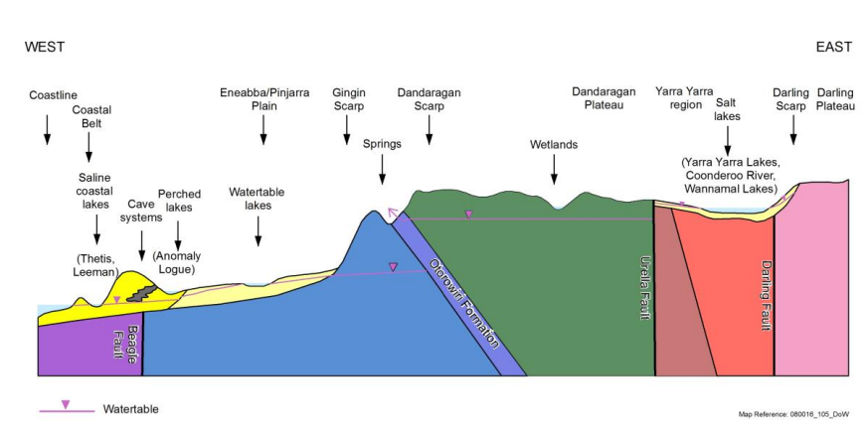

Slide 14
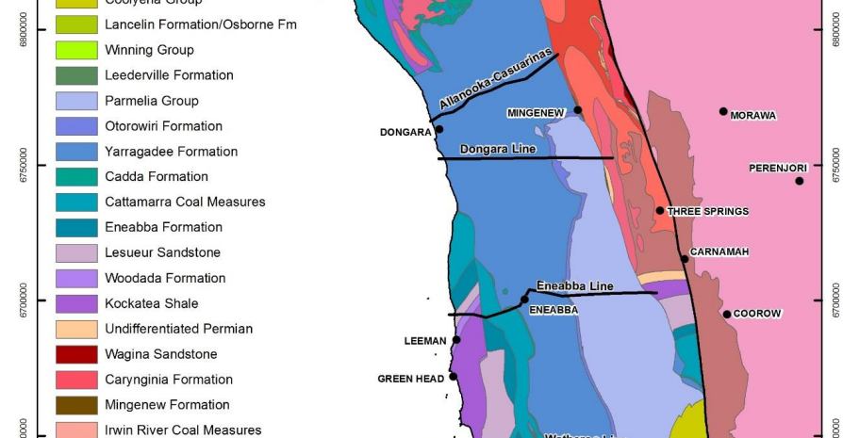

Slide 15
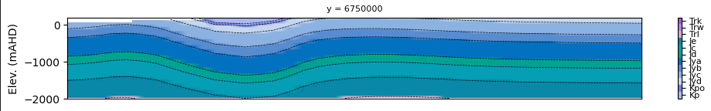
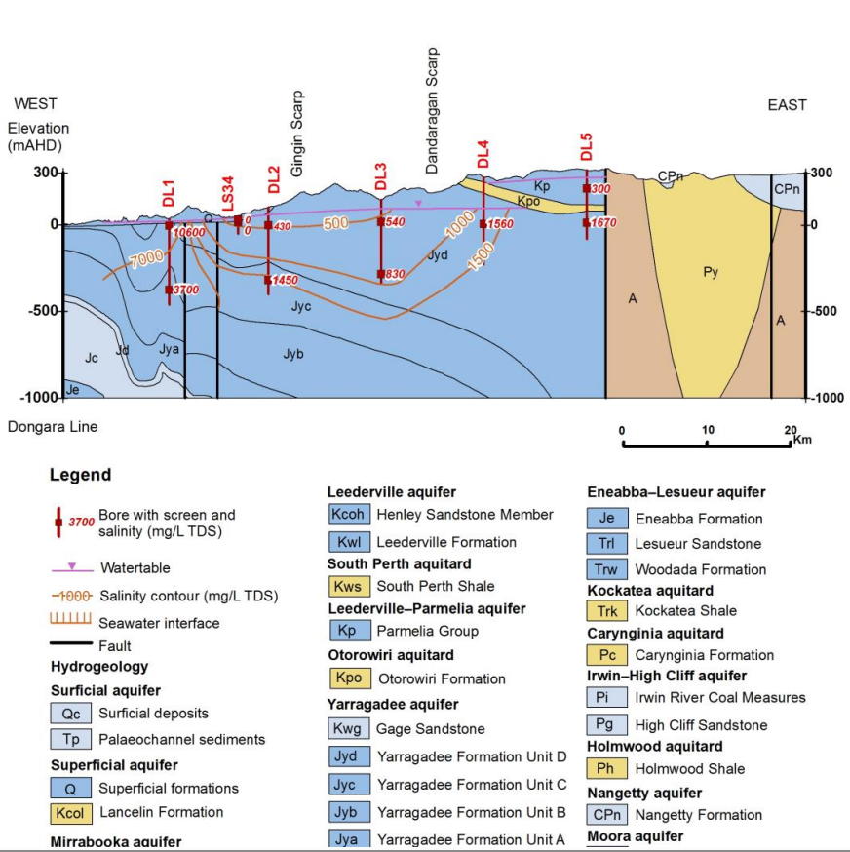

Slide 16
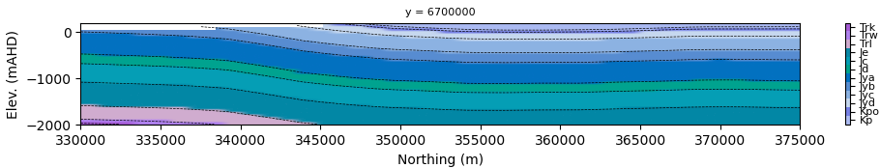
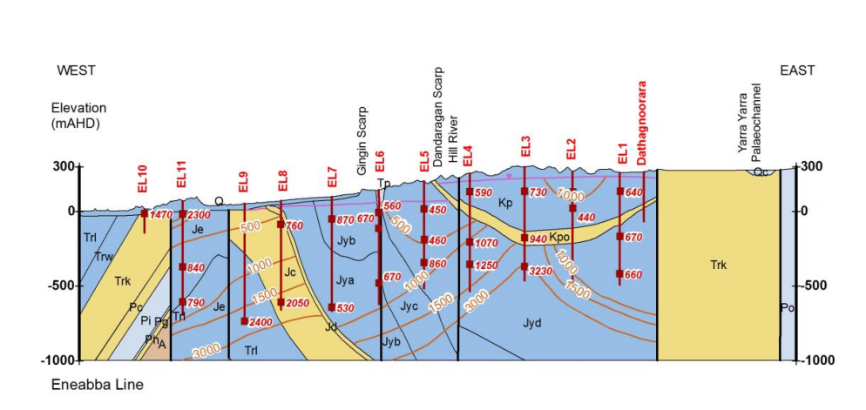

Slide 17
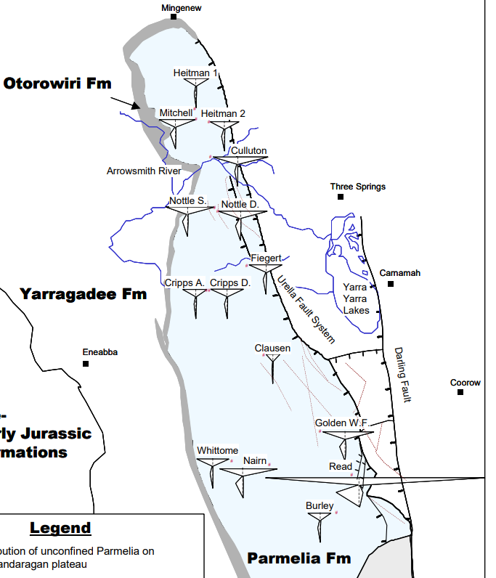
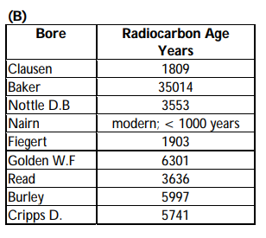

Slide 18
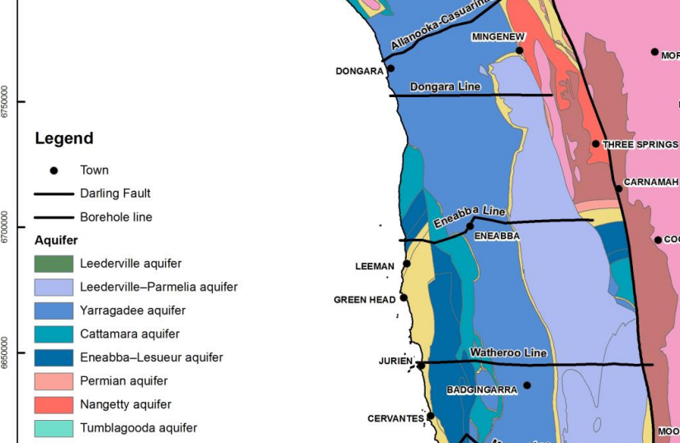

Slide 19
